Slide 1


How to really use Google NotebookLM update Part 1

Slide 2
What you will learn
What is NotebookLM?
Getting NotebookLM
Understanding Notebooks
Using the Notebook Guide
Creating Audio Overviews / Podcasts
Adding Notes
Asking Questions
Working with Answers
Sharing Notebooks
Use Cases

Slide 3

What is NotebookLM?

Slide 4
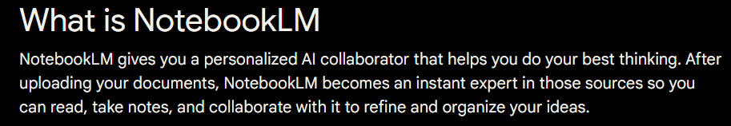
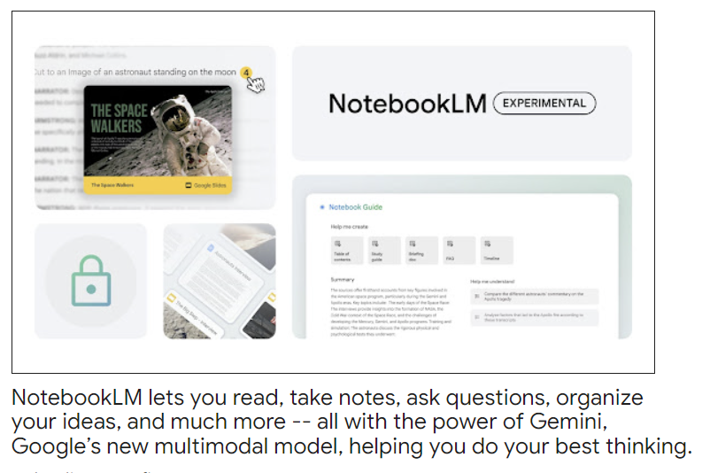
Notes:
https://www.liquid.ai/

Slide 5
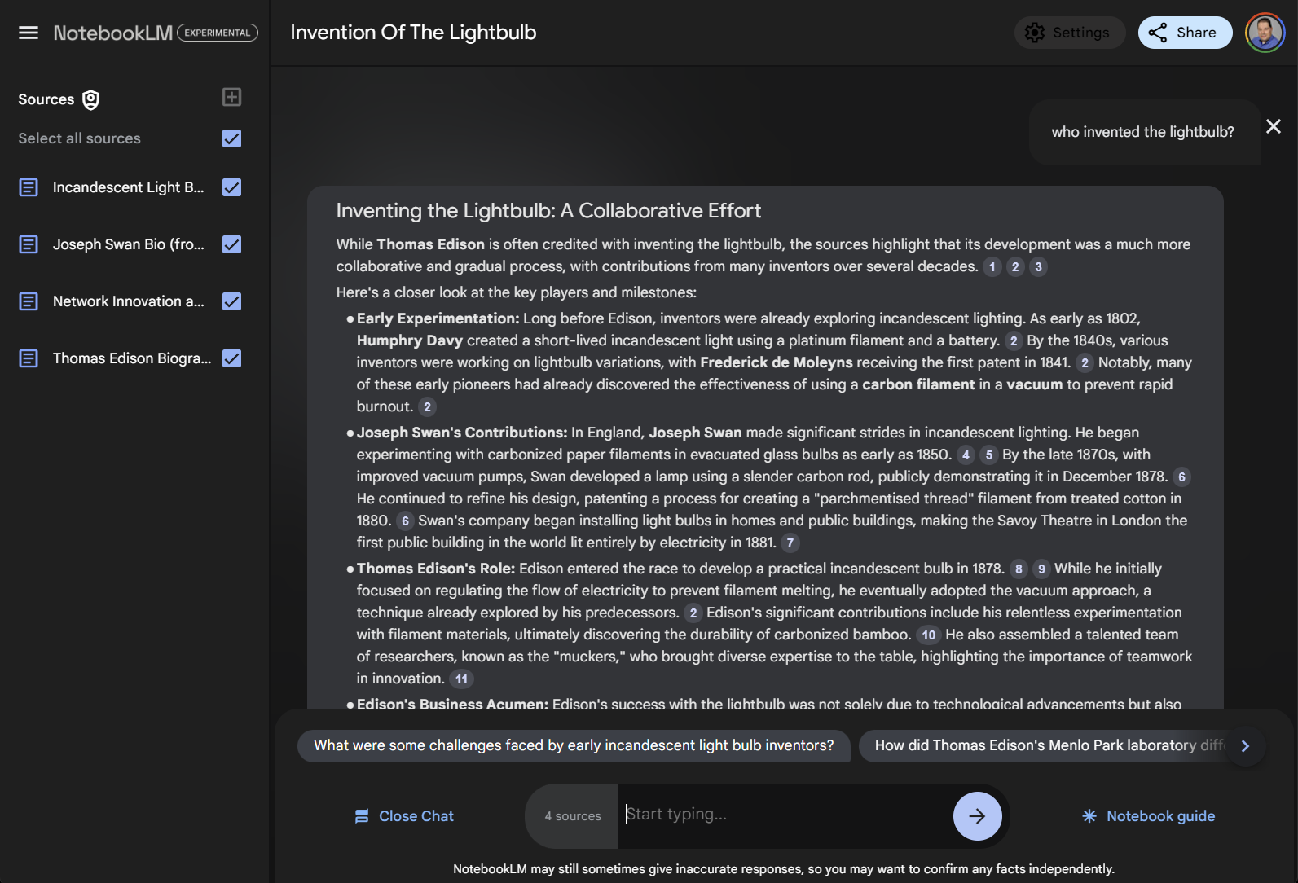
Demo: quick look at NotebookLM

Slide 6

Getting NotebookLM

Slide 7
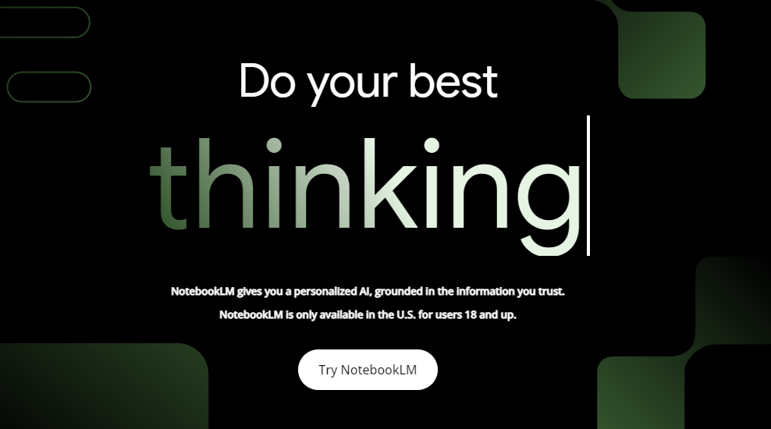
NotebookLM
Notes:
https://notebooklm.google/
https://notebooklm.google.com/

Slide 8
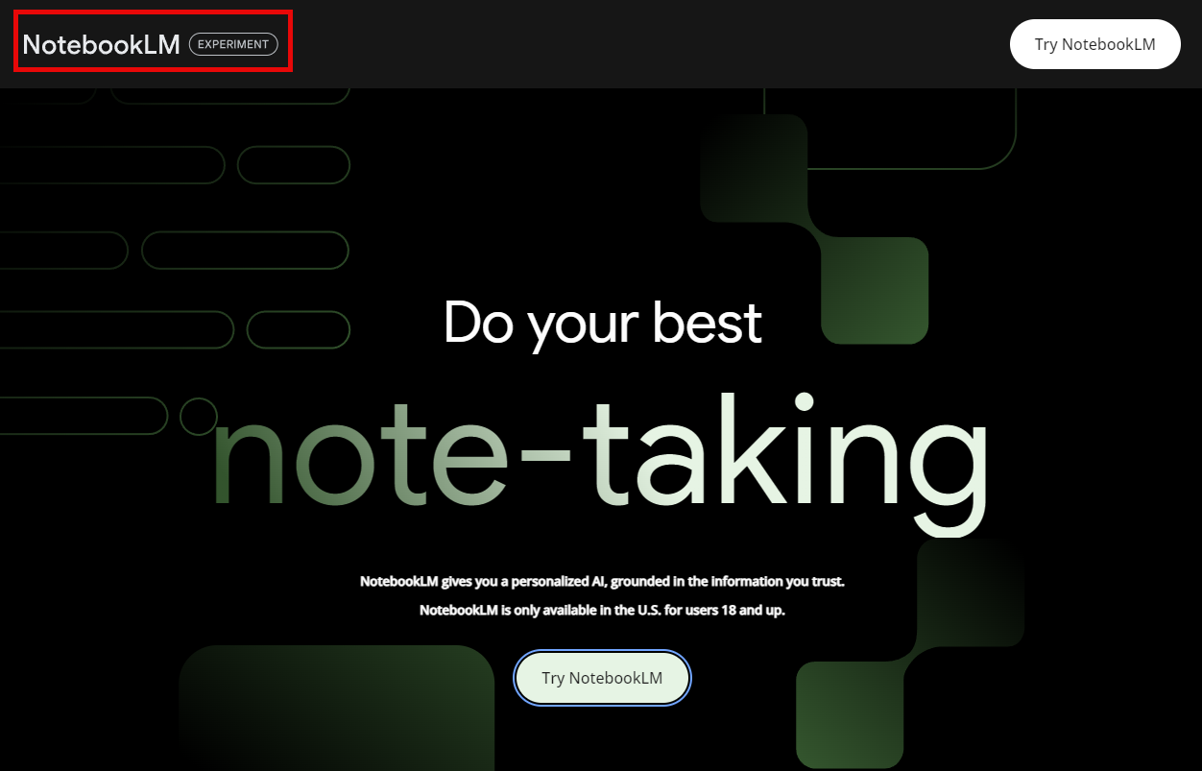
it’s experimental, so…

Slide 9
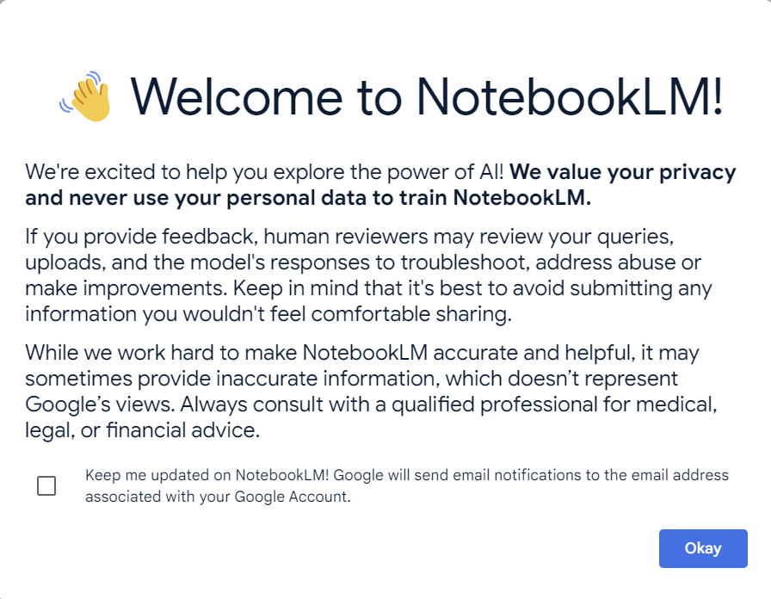
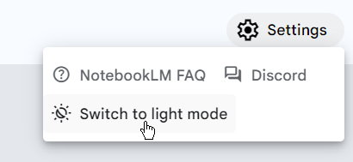

Slide 10
Demo: Getting NotebookLM

Slide 11

Understanding notebooks

Slide 12
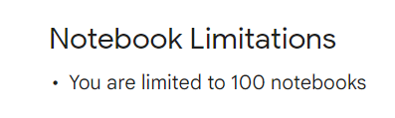
Notes:
https://support.google.com/notebooklm/answer/14276471?hl=en

Slide 13
Notebook
Sources
Notes
Notebook
Sources
Source Guides
Citations
Source Guides
Notes
Citations

Slide 14
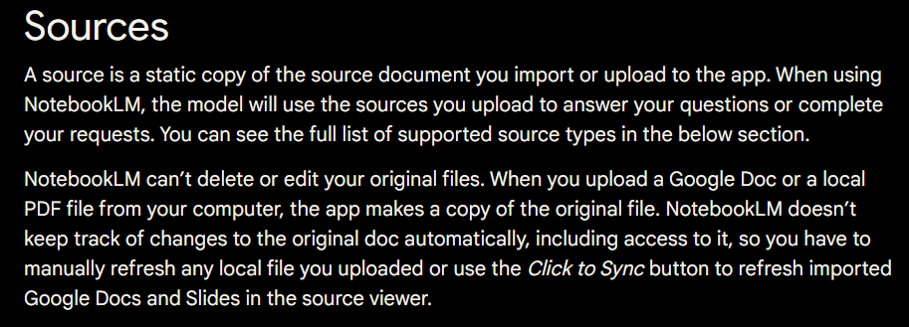
Notes:
https://support.google.com/notebooklm/answer/14276468

Slide 15
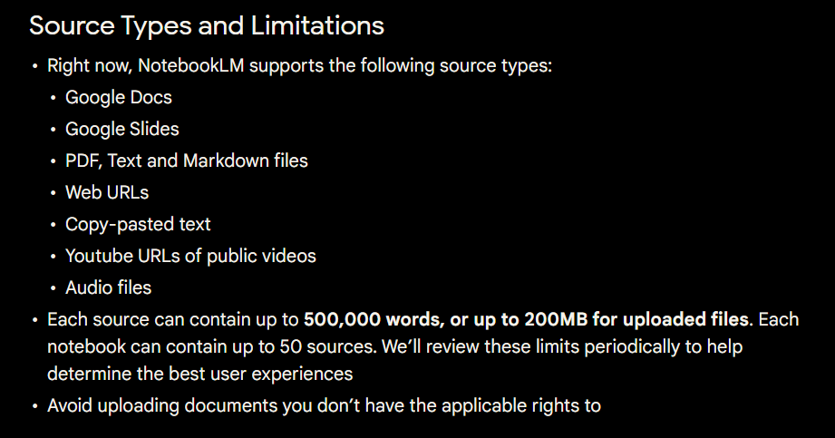
Notes:
https://support.google.com/notebooklm/answer/14276468

Slide 16
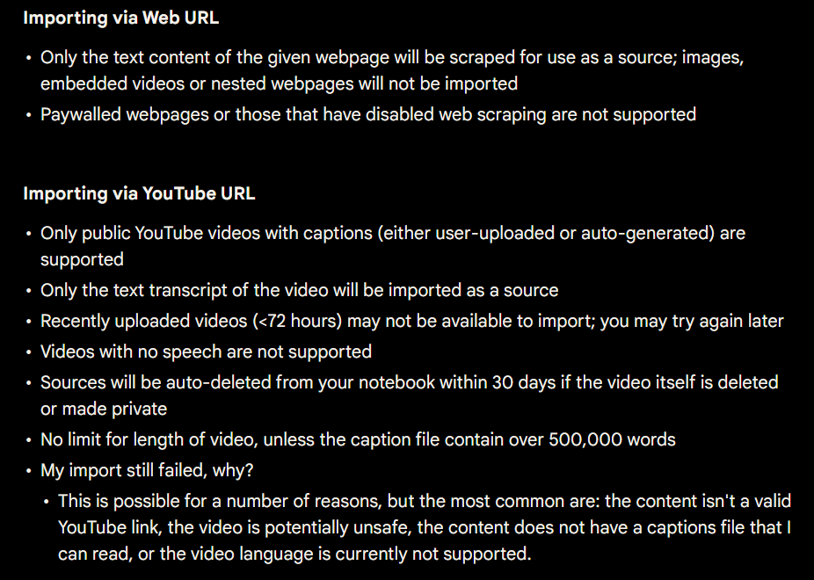
Notes:
https://support.google.com/notebooklm/answer/14276468

Slide 17
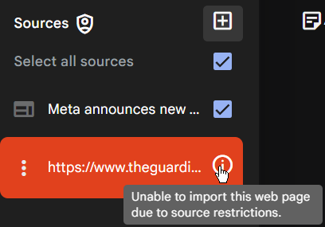
Pro tip: Use https://archive.is/ for most sites

Slide 18
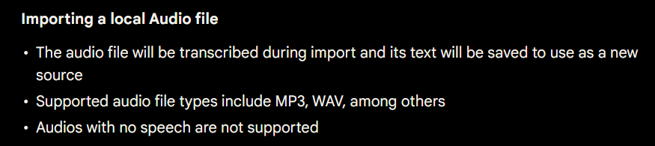
Notes:
https://support.google.com/notebooklm/answer/14276468

Slide 19
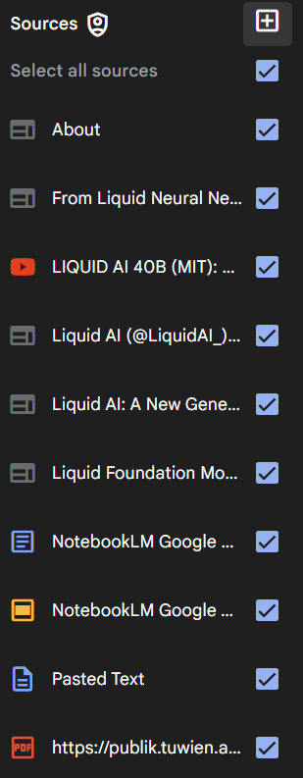
Source icons
Notes:
https://www.liquid.ai/about
https://www.liquid.ai/liquid-foundation-models
https://www.liquid.ai/blog/new-generation-of-ai-models-from-first-principles

Slide 20
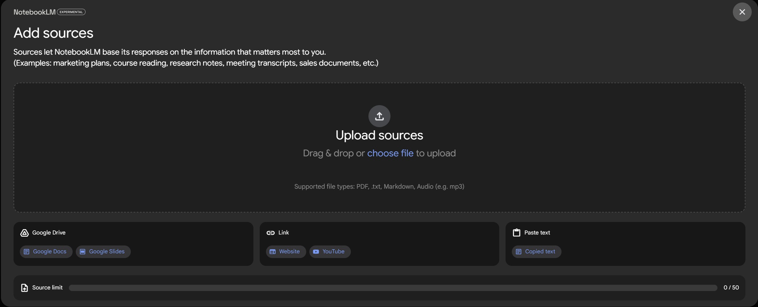

Slide 21
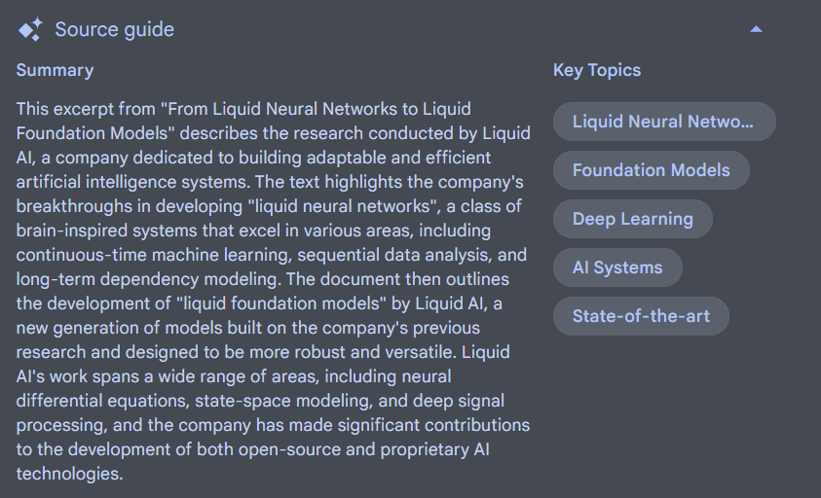
All sources have a source guide

Slide 22
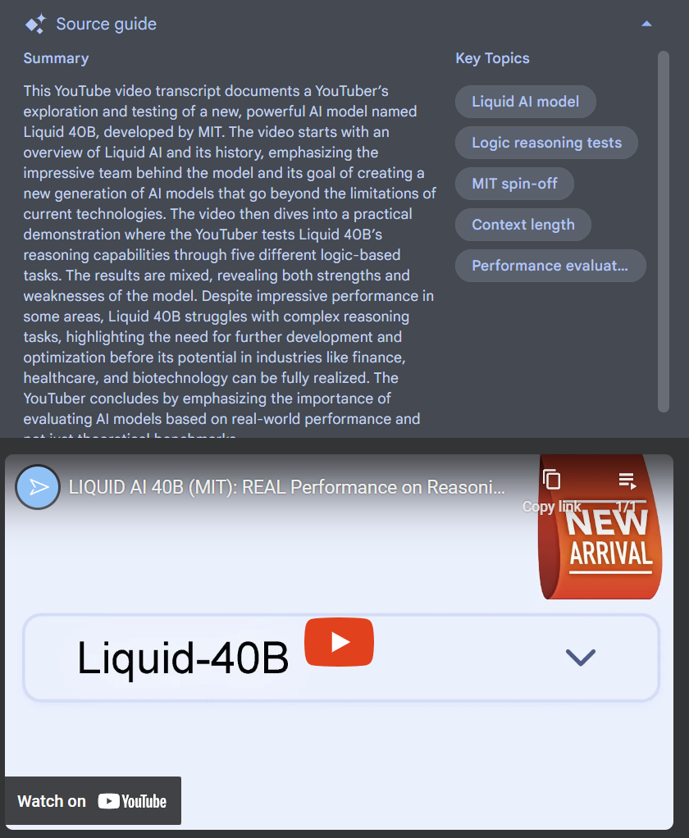
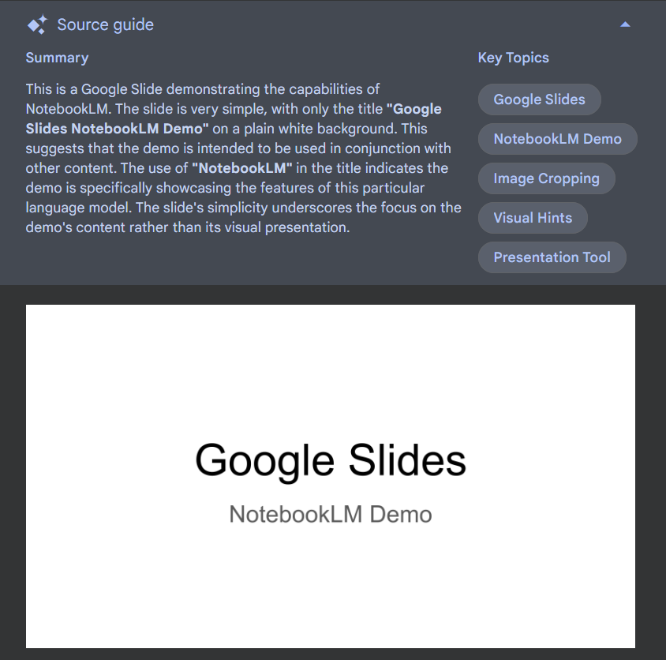
Sources also have additional items specific to their data type

Slide 23
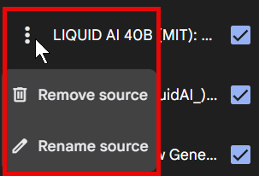
Removing or renaming sources

Slide 24
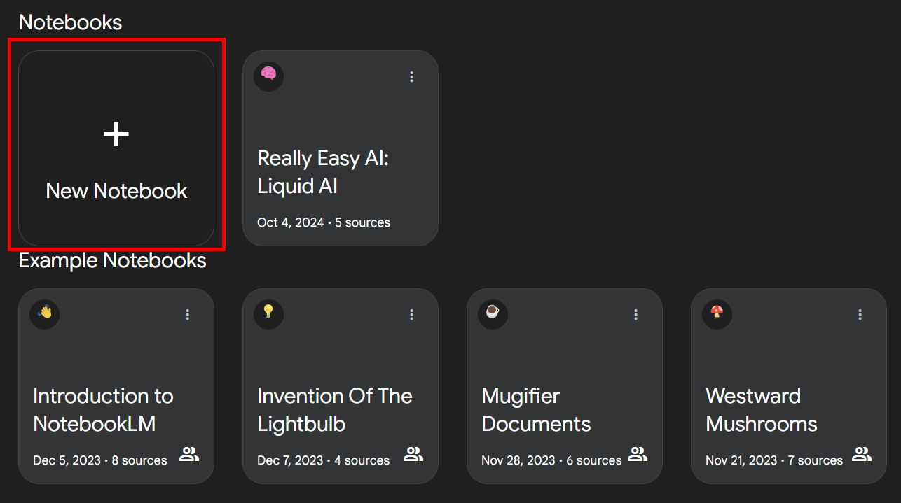
Demo: Creating a new notebook & working with sources

Slide 25




Notes:
https://www.youtube.com/channel/UC35ZpwldGw7ZJ5R-2sLijzw

Slide 26
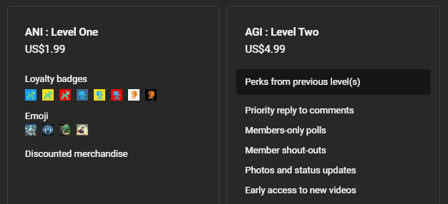
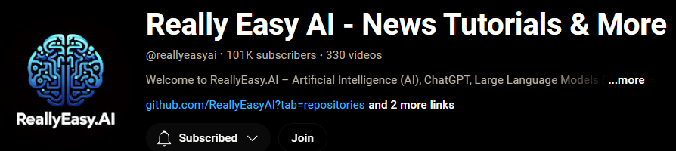
Become a Member!
Notes:
https://www.youtube.com/channel/UC35ZpwldGw7ZJ5R-2sLijzw/join

Slide 27

https://www.youtube.com/@AINewsFresh

Slide 28
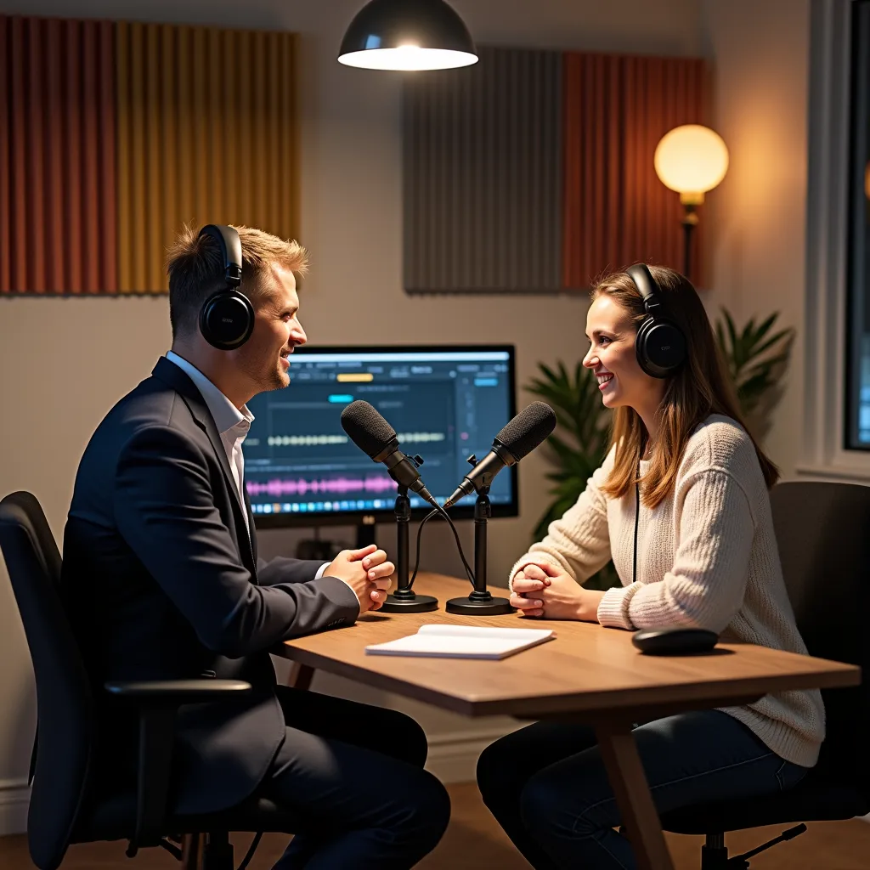
https://www.youtube.com/@DailyAINewsPodcast

Slide 29


